Slide 1
BIEN 401 Biomedical Mass Transport Class 18 Extracorporeal Devices
notes prepared by
Dr. Louis Reis
Created on 4/23/2022

Slide 2
Extracorporeal Devices
Extracorporeal devices are designed to carry out a function that can no longer or cannot temporarily be done by the body.
As the name implies, these are devices that exist outside (extra-) the body (-corporeal).
They are usually connected to a patient by an arteriovenous shunt that diverts blood from an artery through the device and back into a vein.
Usually blood is infused with anticlotting drugs such as __________.
The extracorporeal device system may also include ancillary equipment such as pumps, flow monitors, bubble traps, and pressure and temperature control systems.
Unlike bioartificial organs, these devices generally do not contain live cells.

Slide 3
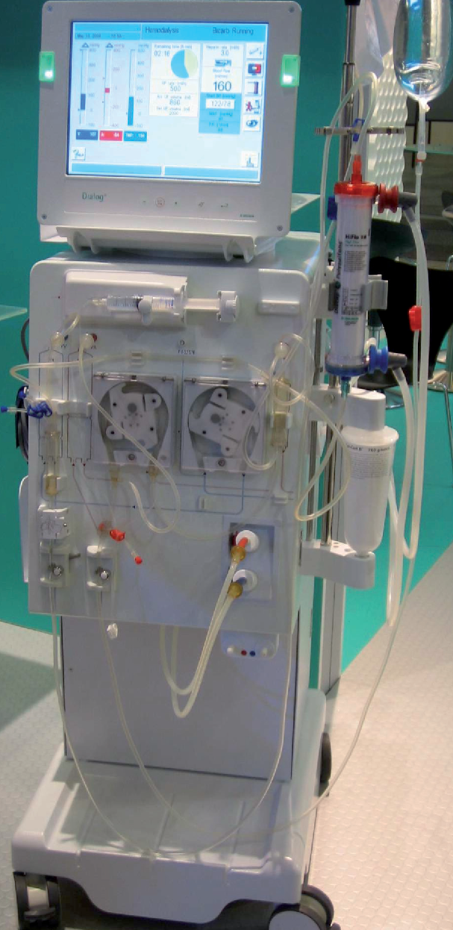
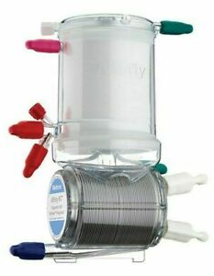
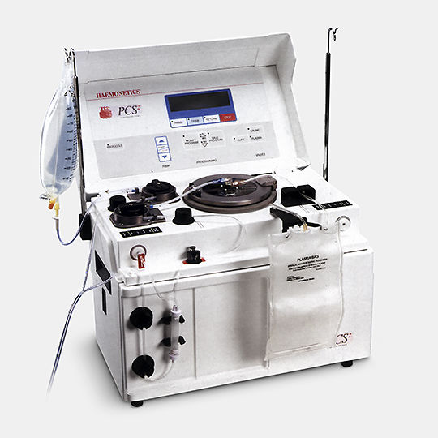
Extracorporeal Devices - Examples
___________ – replaces function of failed kidneys
Blood oxygenators – commonly used in open heart surgery to bypass heart and lungs and oxygenate blood
Aquapheresis - used to remove excess water from body
Hemoperfusion – used to cleanse blood of toxic materials
_____________ – separates plasma from blood
Immobilized enzyme reactors – removes toxic substances; replaces liver function
Affinity columns – removes immune system agents; commonly used in auto-immune diseases and sepsis

Slide 4
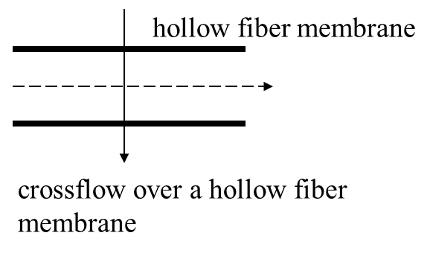
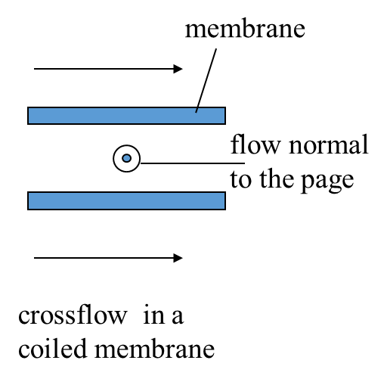
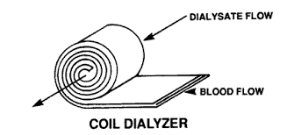
Extracorporeal Devices - Examples
Many devices will incorporate some type of semipermeable membrane to provide the area for mass transfer to occur.
Membranes can be arranged as stacks of flat sheets, coils of membrane sheets, or bundles of hollow fibers.
There are a variety of contacting patterns:
Cocurrent flow – fluid streams flow in same direction
Countercurrent flow – fluid streams flow in opposite directions
Cross flow – fluid streams flow perpendicular to each other
membrane

Slide 5
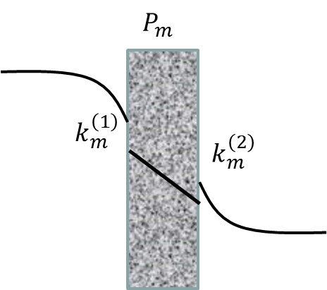
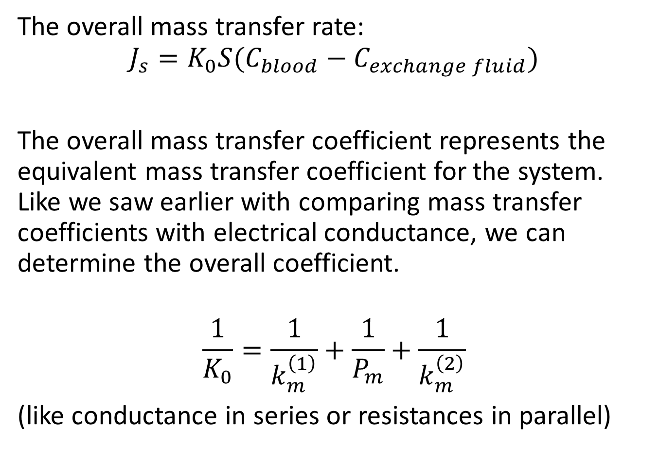
Overall Mass Transfer Coefficient - Review
The overall mass transfer rate:
$$J_{s}=K_{0}S(C_{blood}−C_{exchange fluid})$$
The overall mass transfer coefficient represents the equivalent mass transfer coefficient for the system. Like we saw earlier with comparing mass transfer coefficients with electrical conductance, we can determine the overall coefficient.
$$\frac{1}{K_{0}}=\frac{1}{k_{m}^{\left(1\right)}}+\frac{1}{P_{m}}+\frac{1}{k_{m}^{\left(2\right)}}$$
(like conductance in series or resistances in parallel)

Slide 6
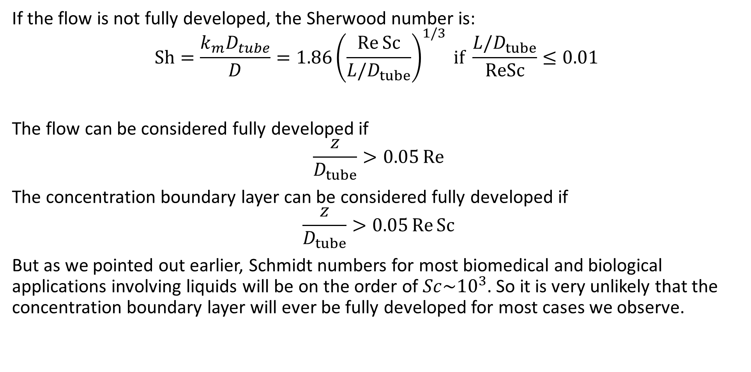
Fully Developed Flow and Sherwood Number - Review
If the flow is not fully developed, the Sherwood number is:
$$\text{Sh}=\frac{k_{m}D_{tube}}{D}=1.86{\left(\frac{\text{Re} \text{Sc}}{L/D_{tube}}\right)}^{1/3} \text{if} \frac{L/D_{tube}}{\text{ReSc}}≤0.01$$
The flow can be considered fully developed if
$$\frac{z}{D_{tube}}>0.05 \text{Re}$$
The concentration boundary layer can be considered fully developed if
$$\frac{z}{D_{tube}}>0.05 \text{Re} \text{Sc}$$
But as we pointed out earlier, Schmidt numbers for most biomedical and biological applications involving liquids will be on the order of $Sc\sim {10}^{3}$. So it is very unlikely that the concentration boundary layer will ever be fully developed for most cases we observe.

Slide 7
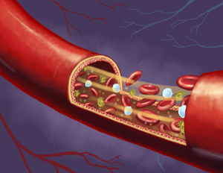
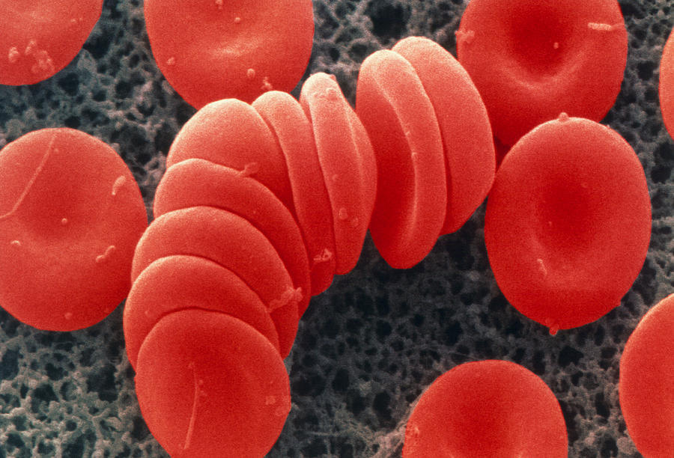
Factors Affecting Mass Transport in Blood
Suspension properties
_______________________
Volume fraction of proteins
RBC solute permeability
Solute behavior
Protein binding kinetics/equilibrium
Reactions with other solutes
Flow-dependent properties
Rheological properties (density, viscosity, etc.)
RBC flow dynamics
____________ formation
Migration from wall
RBC rotation and translation

Slide 8
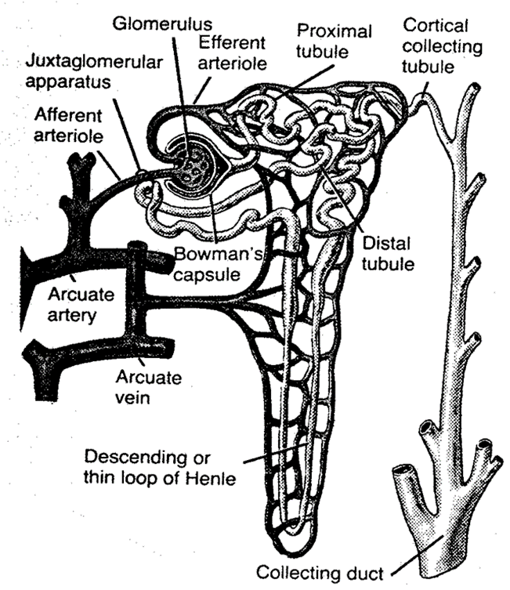
Kidney Failure
The basic function unit of a kidney is the nephron, with each kidney containing about 1 million nephrons.
Our bodies need at least 1/3 of these nephrons to function properly to keep concentrations of waste products low and stable.
If about 90% of the nephrons fail, then the patient will develop __________.
Failure to remove excessive water from the blood will lead to edema which will build up in the cells due to electrolyte imbalances.
Removal of acidic products of metabolism will lead to ____________ causing the body’s pH levels to drop and eventually cause uremic coma.
Nitrogenous waste products like ______, uric acid, and creatine must be removed to ensure protein metabolism.
Kidney failure, if left untreated, can lead to death in a few days.

Slide 9
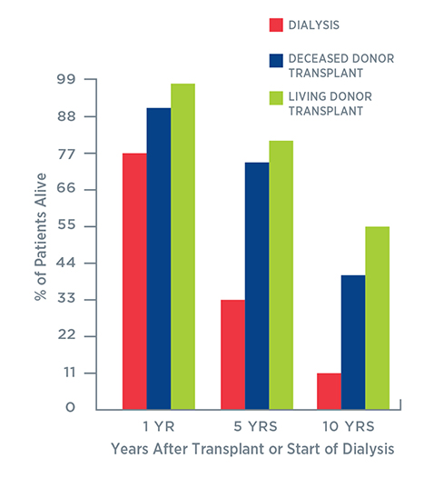
Hemodialysis
Hemodialysis, developed in the 1940s, is used to treat patients with degenerative kidney failure or renal disease.
Nearly 500,000 patients in the US are treated with hemodialysis.
Can extend the life of patients by years; usually long enough for many to receive a __________ _____________.
Used to remove excess fluid and toxic waste products from the body and maintain the correct electrolyte balance.

Slide 10
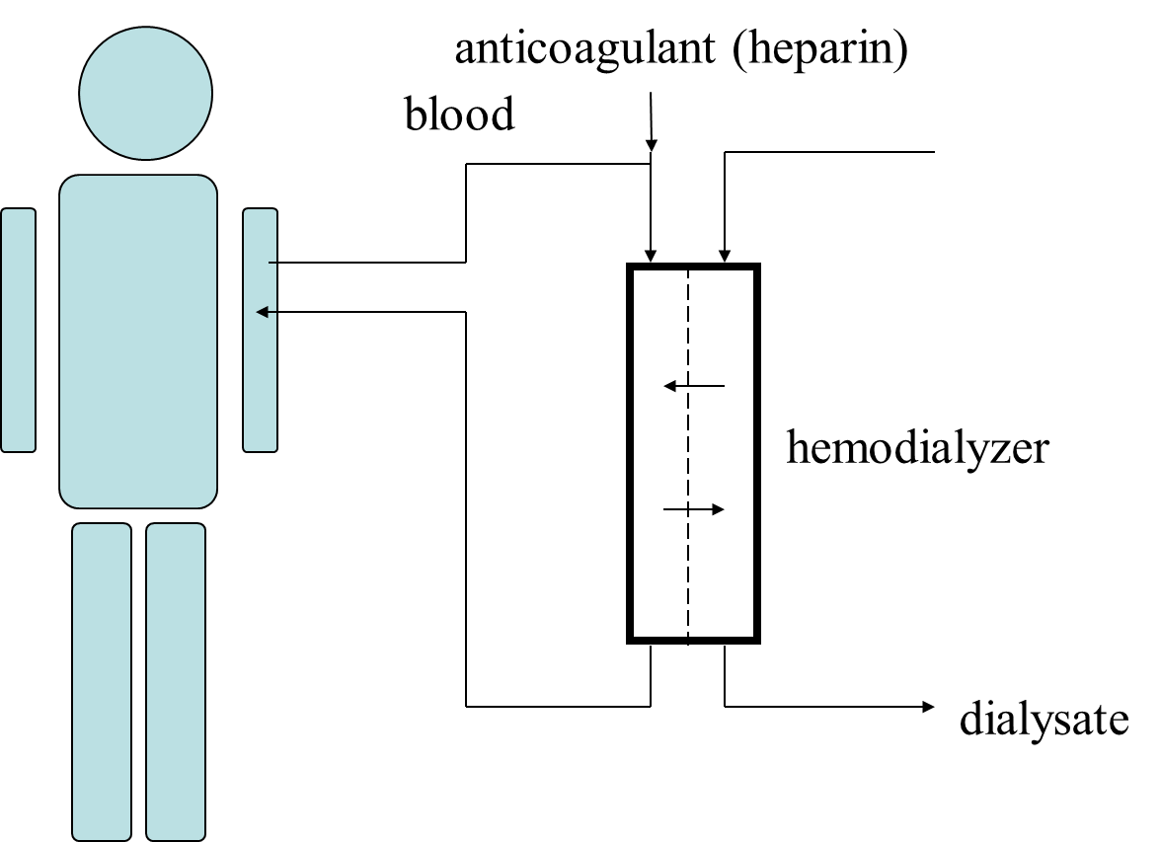
Hemodialysis
Heparinized blood (blood infused with anti-coagulant heparin) flows into hemodialyzer.
In the hemodialyzer, the __________ or exchange fluid is separated from the blood by a semipermeable membrane.
A variety of flow patterns and membrane patterns can be used.
Membranes originally were made of cellulose and cellulose acetate; modern membranes are mad of polycarbonate, ___________, polyacrylonitrile, and other synthetic polymers.
The total membrane surface area is between 1-2 m².
Blood flow rates through the dialyzer are in the range of 100s of mL/min; the flow of the dialysate is usually twice that of blood.

Slide 11
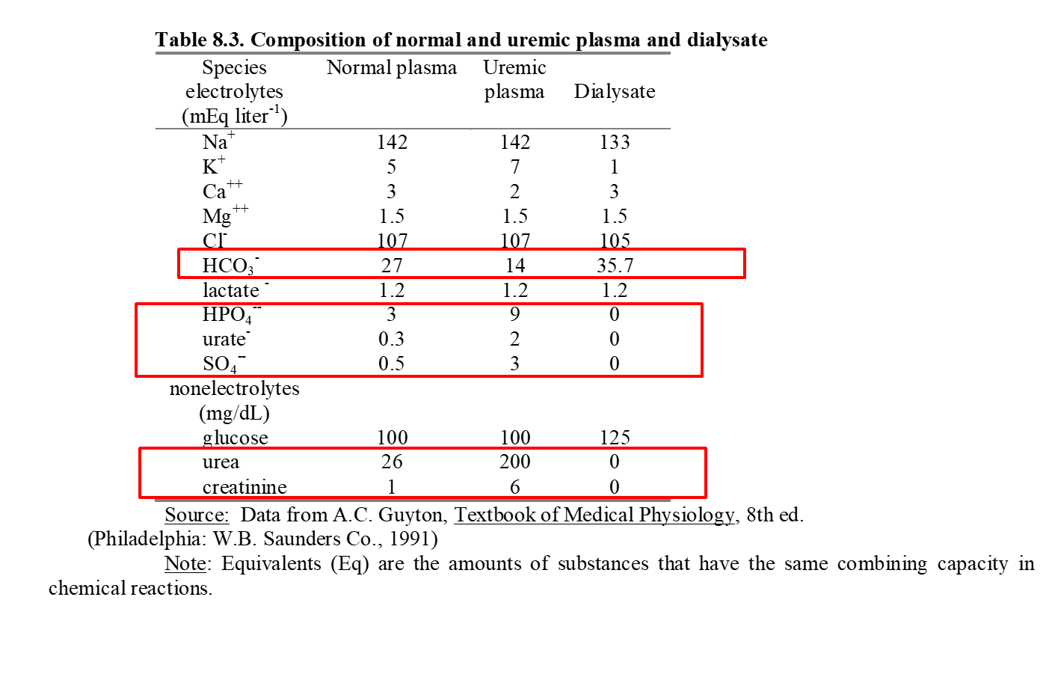
Dialysate Composition
Goal of hemodialysis is to return the uremic plasma to normal.
To maintain a health pH and decrease the acidity of the plasma, HCO₃⁻ is added to the dialysate.
Removing waste products too quickly can lead to _______________ syndrome, which may lead to increase water flow from the plasma to the cerebrospinal fluid causing increase pressure in the cranial cavity.
It is critical to remove as much urea and creatine as possible
Given the additional proteins in blood that will create an osmotic pressure that draws water from the dialysate into blood, the dialysate is operated at a slight ____________, in order for excess water to be removed properly.

Slide 12
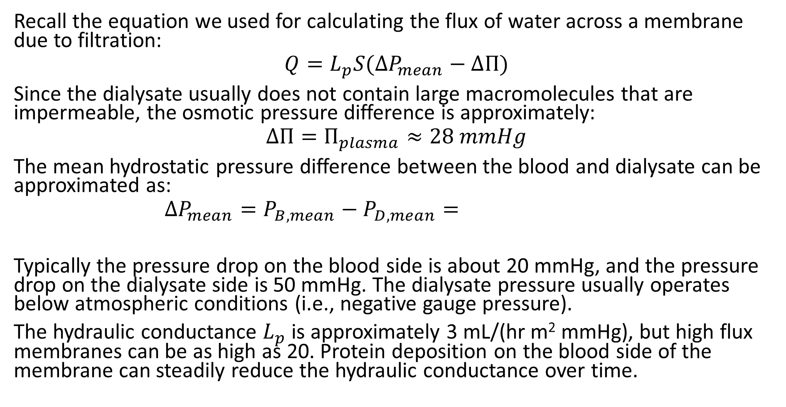
Ultrafiltration
Recall the equation we used for calculating the flux of water across a membrane due to filtration:
$$Q=L_{p}S(∆P_{mean}−∆Π)$$
Since the dialysate usually does not contain large macromolecules that are impermeable, the osmotic pressure difference is approximately:
$$∆Π=Π_{plasma}≈28 mmHg$$
The mean hydrostatic pressure difference between the blood and dialysate can be approximated as:
$$∆P_{mean}=P_{B,mean}−P_{D,mean}=$$
Typically the pressure drop on the blood side is about 20 mmHg, and the pressure drop on the dialysate side is 50 mmHg. The dialysate pressure usually operates below atmospheric conditions (i.e., negative gauge pressure).
The hydraulic conductance $L_{p}$ is approximately 3 mL/(hr m² mmHg), but high flux membranes can be as high as 20. Protein deposition on the blood side of the membrane can steadily reduce the hydraulic conductance over time.

Slide 13

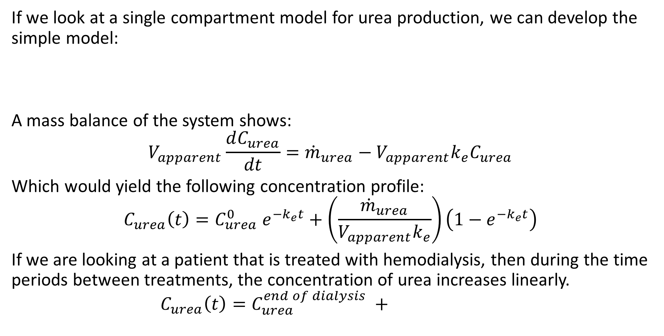

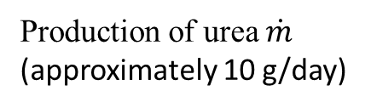
Pharmacokinetic Model of Urea Production and Removal
If we look at a single compartment model for urea production, we can develop the simple model:
A mass balance of the system shows:
$$V_{apparent}\frac{dC_{urea}}{dt}={\dot{m}}_{urea}−V_{apparent}k_{e}C_{urea}$$
Which would yield the following concentration profile:
$$C_{urea}\left(t\right)=C_{urea}^{0} e^{−k_{e}t}+\left(\frac{{\dot{m}}_{urea}}{V_{apparent}k_{e}}\right)\left(1−e^{−k_{e}t}\right)$$
If we are looking at a patient that is treated with hemodialysis, then during the time periods between treatments, the concentration of urea increases linearly.
$$C_{urea}\left(t\right)=C_{urea}^{end of dialysis} +$$
$$V_{apparent}; C_{total}$$
(Body)
Production of urea $\dot{m}$
(approximately 10 g/day)
$$k_{e}=\frac{{\text{CL}}_{d}}{V_{apparent}}$$

Slide 14
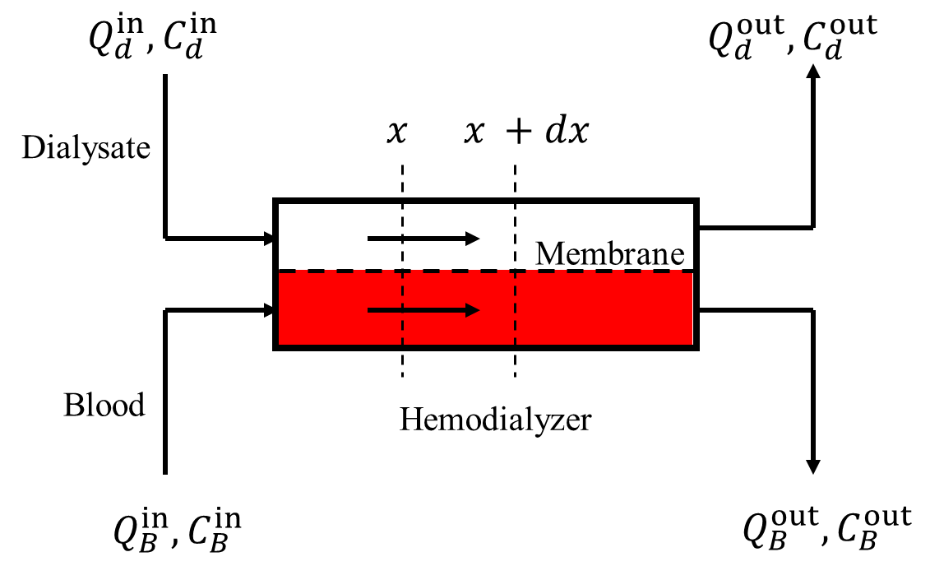
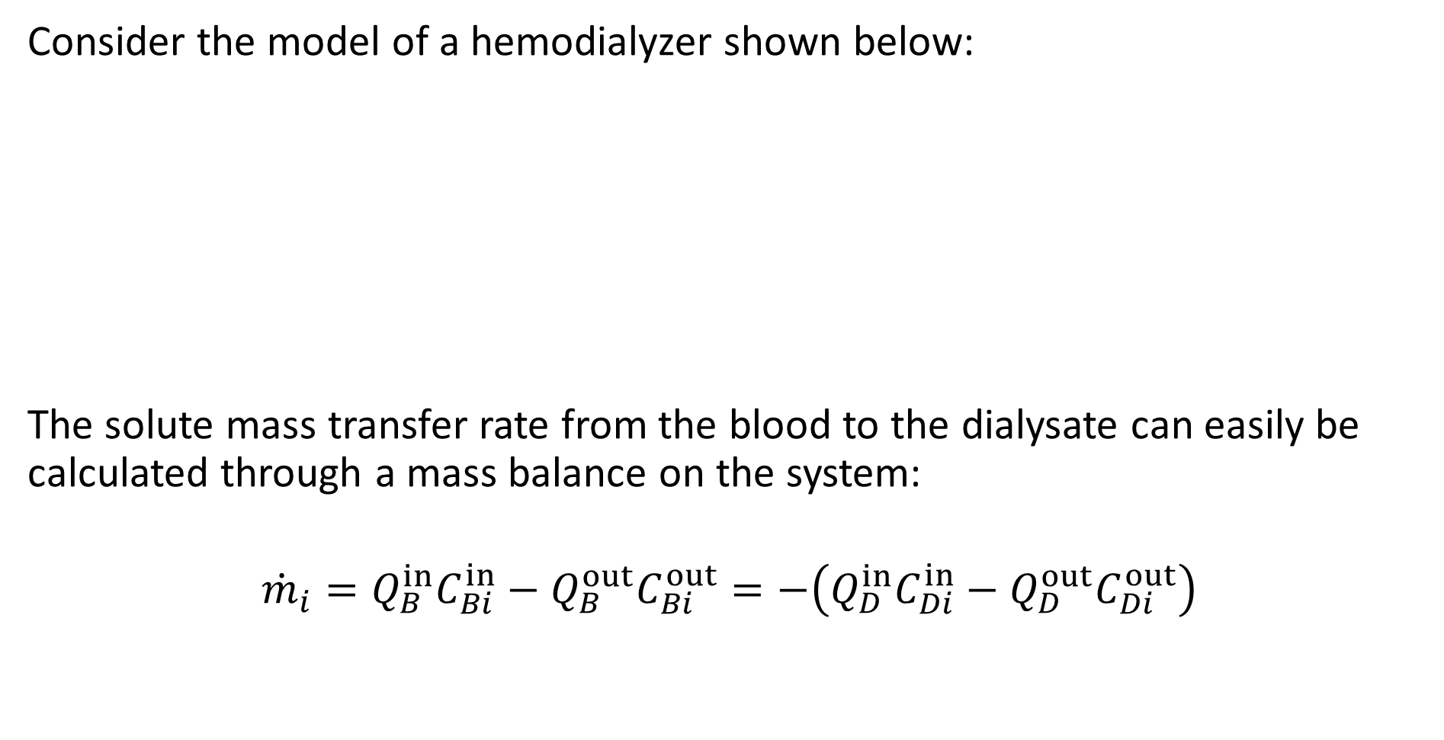
Solute Transfer
Consider the model of a hemodialyzer shown below:
The solute mass transfer rate from the blood to the dialysate can easily be calculated through a mass balance on the system:
$${\dot{m}}_{i}=Q_{B}^{in}C_{Bi}^{in}−Q_{B}^{out}C_{Bi}^{out}=−\left(Q_{D}^{in}C_{Di}^{in}−Q_{D}^{out}C_{Di}^{out}\right)$$

Slide 15
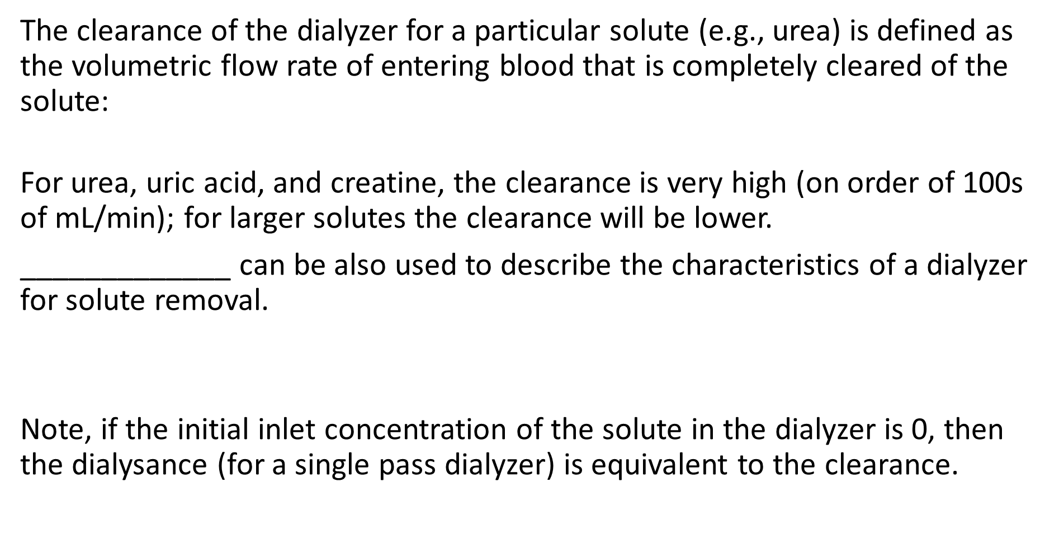
Clearance and Dialysance
The clearance of the dialyzer for a particular solute (e.g., urea) is defined as the volumetric flow rate of entering blood that is completely cleared of the solute:
For urea, uric acid, and creatine, the clearance is very high (on order of 100s of mL/min); for larger solutes the clearance will be lower.
_____________ can be also used to describe the characteristics of a dialyzer for solute removal.
Note, if the initial inlet concentration of the solute in the dialyzer is 0, then the dialysance (for a single pass dialyzer) is equivalent to the clearance.

Slide 16
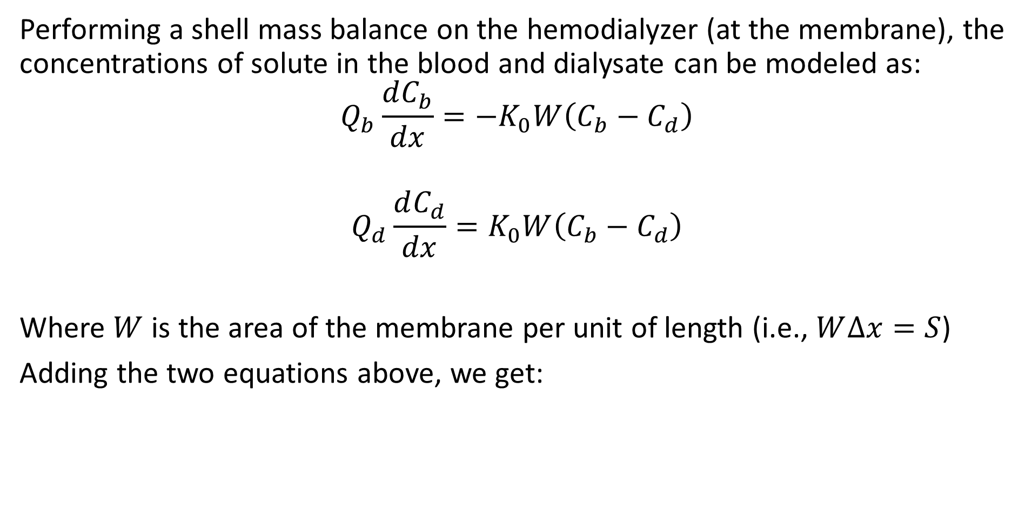
Solute Transfer
Performing a shell mass balance on the hemodialyzer (at the membrane), the concentrations of solute in the blood and dialysate can be modeled as:
$$Q_{b}\frac{dC_{b}}{dx}=−K_{0}W\left(C_{b}−C_{d}\right)$$
$$Q_{d}\frac{dC_{d}}{dx}=K_{0}W\left(C_{b}−C_{d}\right)$$
Where $W$ is the area of the membrane per unit of length (i.e., $W∆x=S$)
Adding the two equations above, we get:

Slide 17
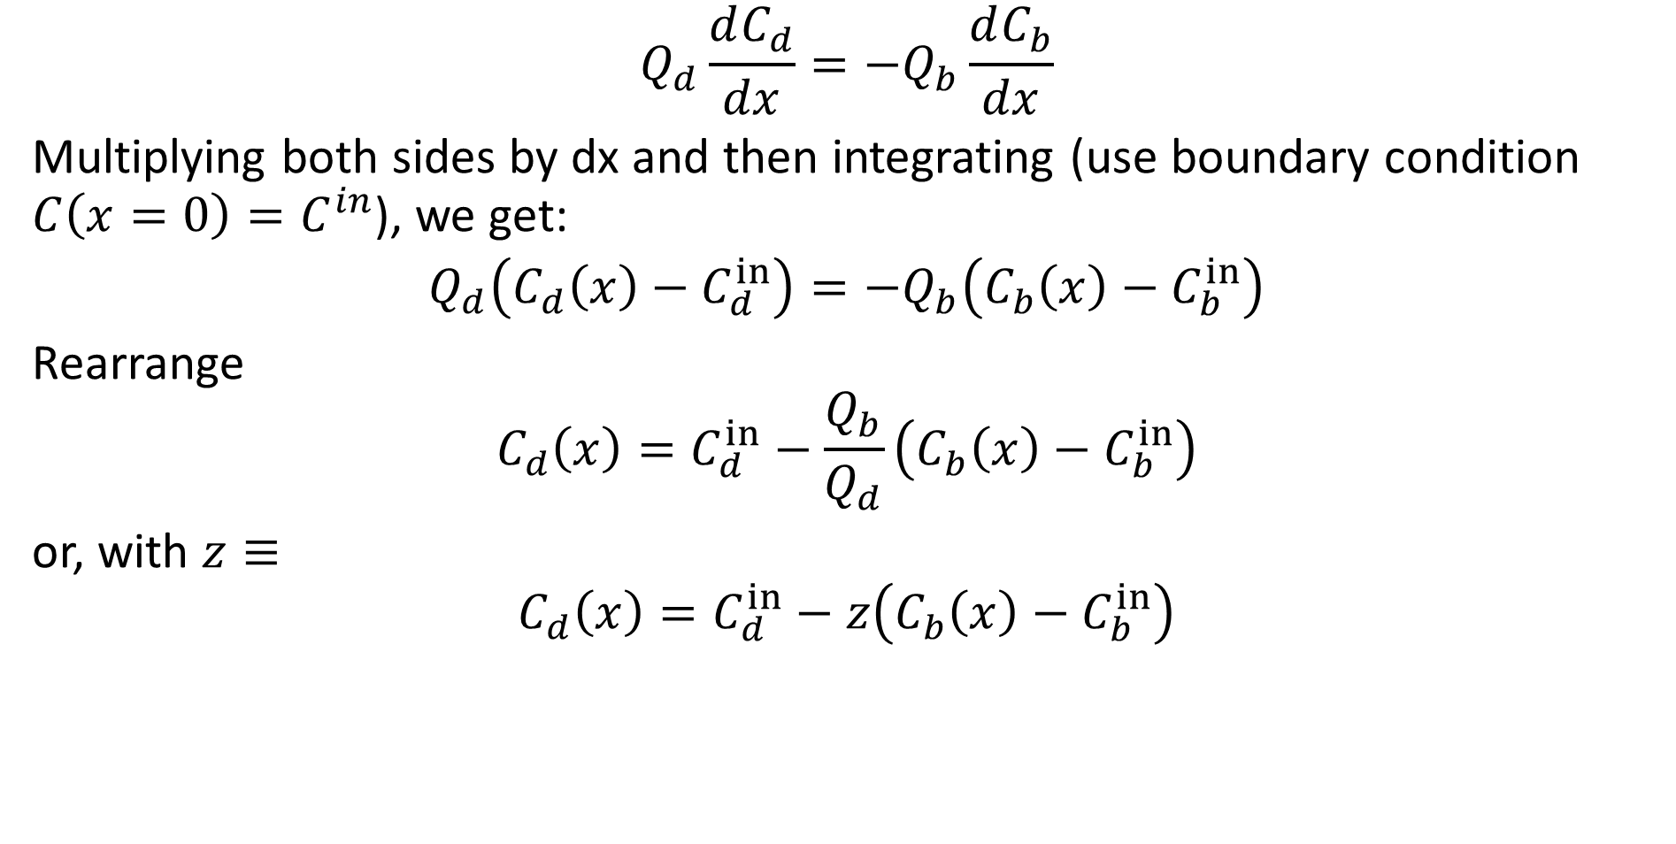
Solute Transfer
$$Q_{d}\frac{dC_{d}}{dx}=−Q_{b}\frac{dC_{b}}{dx}$$
Multiplying both sides by dx and then integrating (use boundary condition $C\left(x=0\right)=C^{in}$), we get:
$$Q_{d}\left(C_{d}\left(x\right)−C_{d}^{in}\right)={−Q}_{b}\left(C_{b}\left(x\right)−C_{b}^{in}\right)$$
Rearrange
$$C_{d}\left(x\right)=C_{d}^{in}−\frac{Q_{b}}{Q_{d}}\left(C_{b}\left(x\right)−C_{b}^{in}\right)$$
or, with $z≡$
$$C_{d}\left(x\right)=C_{d}^{in}−z\left(C_{b}\left(x\right)−C_{b}^{in}\right)$$

Slide 18
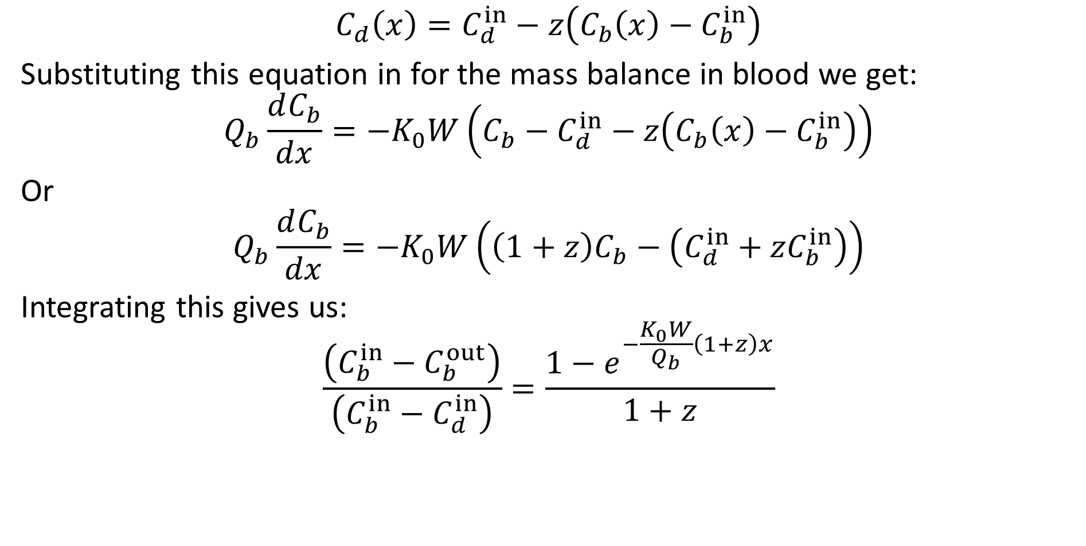
Solute Transfer
$$C_{d}\left(x\right)=C_{d}^{in}−z\left(C_{b}\left(x\right)−C_{b}^{in}\right)$$
Substituting this equation in for the mass balance in blood we get:
$$Q_{b}\frac{dC_{b}}{dx}=−K_{0}W\left(C_{b}−C_{d}^{in}−z\left(C_{b}\left(x\right)−C_{b}^{in}\right)\right)$$
Or
$$Q_{b}\frac{dC_{b}}{dx}=−K_{0}W\left({\left(1+z\right)C}_{b}−\left(C_{d}^{in}+zC_{b}^{in}\right)\right)$$
Integrating this gives us:
$$\frac{\left(C_{b}^{in}−C_{b}^{out}\right)}{\left(C_{b}^{in}−C_{d}^{in}\right)}=\frac{1−e^{−\frac{K_{0}W}{Q_{b}}\left(1+z\right)x}}{1+z}$$

Slide 19
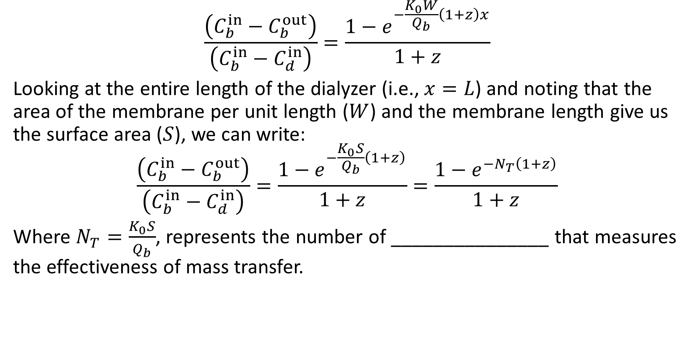
Solute Transfer
$$\frac{\left(C_{b}^{in}−C_{b}^{out}\right)}{\left(C_{b}^{in}−C_{d}^{in}\right)}=\frac{1−e^{−\frac{K_{0}W}{Q_{b}}\left(1+z\right)x}}{1+z}$$
Looking at the entire length of the dialyzer (i.e., $x=L$) and noting that the area of the membrane per unit length ($W$) and the membrane length give us the surface area ($S$), we can write:
$$\frac{\left(C_{b}^{in}−C_{b}^{out}\right)}{\left(C_{b}^{in}−C_{d}^{in}\right)}=\frac{1−e^{−\frac{K_{0}S}{Q_{b}}\left(1+z\right)}}{1+z}=\frac{1−e^{−N_{T}\left(1+z\right)}}{1+z}$$
Where $N_{T}=\frac{K_{0}S}{Q_{b}}$, represents the number of _______________ that measures the effectiveness of mass transfer.

Slide 20
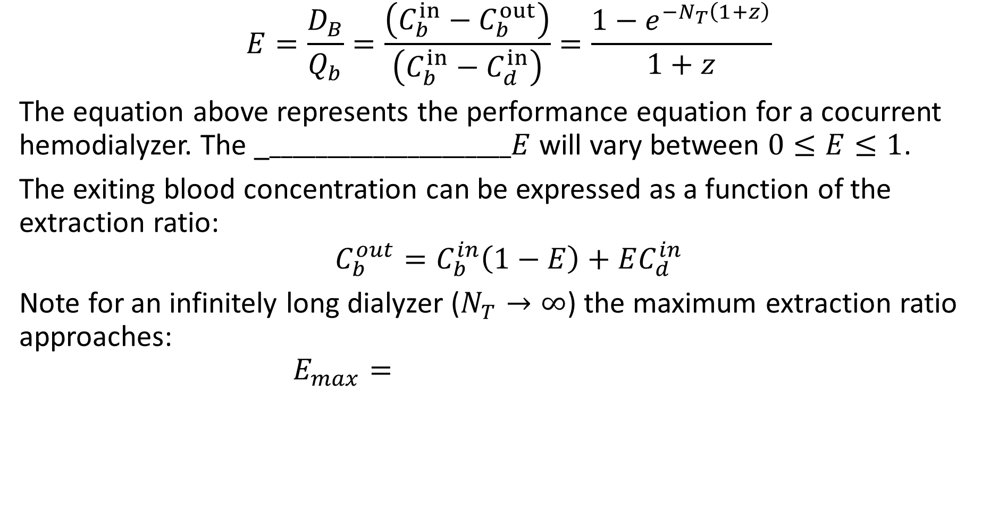
Effectiveness and Extraction Ratio
$$E=\frac{D_{B}}{Q_{b}}=\frac{\left(C_{b}^{in}−C_{b}^{out}\right)}{\left(C_{b}^{in}−C_{d}^{in}\right)}=\frac{1−e^{−N_{T}\left(1+z\right)}}{1+z}$$
The equation above represents the performance equation for a cocurrent hemodialyzer. The _$_____________________E$ will vary between $0≤E≤1$.
The exiting blood concentration can be expressed as a function of the extraction ratio:
$$C_{b}^{out}=C_{b}^{in}\left(1−E\right)+EC_{d}^{in}$$
Note for an infinitely long dialyzer ($N_{T}→∞$) the maximum extraction ratio approaches:
$$E_{max}=$$

Slide 21
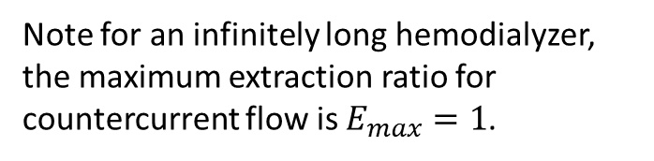
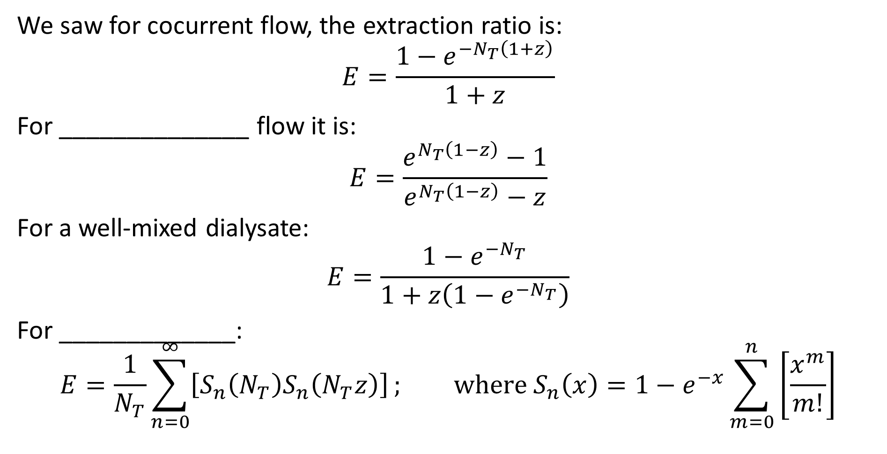
Effectiveness and Extraction Ratio
We saw for cocurrent flow, the extraction ratio is:
$$E=\frac{1−e^{−N_{T}\left(1+z\right)}}{1+z}$$
For ______________ flow it is:
$$E=\frac{e^{N_{T}\left(1−z\right)}−1}{e^{N_{T}\left(1−z\right)}−z}$$
For a well-mixed dialysate:
$$E=\frac{1−e^{−N_{T}}}{1+z\left(1−e^{−N_{T}}\right)}$$
For _____________:
$$E=\frac{1}{N_{T}}\sum_{n=0}^{∞}{\left[S_{n}\left(N_{T}\right)S_{n}\left(N_{T}z\right)\right]}; \text{where} S_{n}\left(x\right)=1−e^{−x}\sum_{m=0}^{n}{\left[\frac{x^{m}}{m!}\right]}$$
Note for an infinitely long hemodialyzer, the maximum extraction ratio for countercurrent flow is $E_{max}=1$.

Slide 22
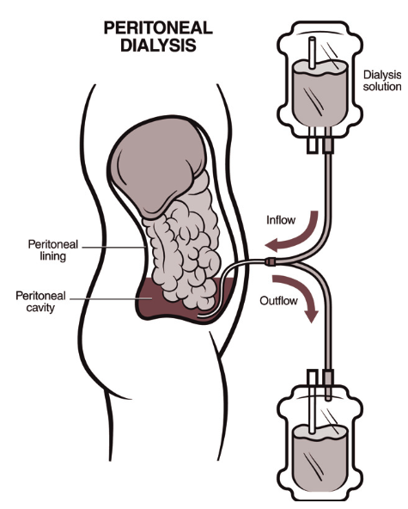
Peritoneal Dialysis
An alternative approach for treating kidney failure is continuous ambulatory ___________________ (CAPD) or peritoneal dialysis for short.
Peritoneal cavity is filled with about 2 liters of dialysis fluid for about 2 hours.
Peritoneal membrane acts as the dialysis membrane.
Fluid is replaced about ______ times per day.
Spent fluid is disposed of in a regular toilet.
The inlet and drain bags are disposed of in the trash.
Roughly 15% of the dialysis population now uses CAPD.

Slide 23
Peritoneal Dialysis
Advantages:
Travel to a dialysis clinic is unnecessary.
No vascular access is needed, but peritoneal catheterization is required.
Patient is not tethered to the dialysis machine.
Can be done while the patient is sleeping.
Disadvantages
Risk of _____________.
Risk of infection at the catheter site.
More restrictive carbohydrate consumption restrictions.
Sometimes a bloating feeling.
Sometimes a “filling pain.”

Slide 24
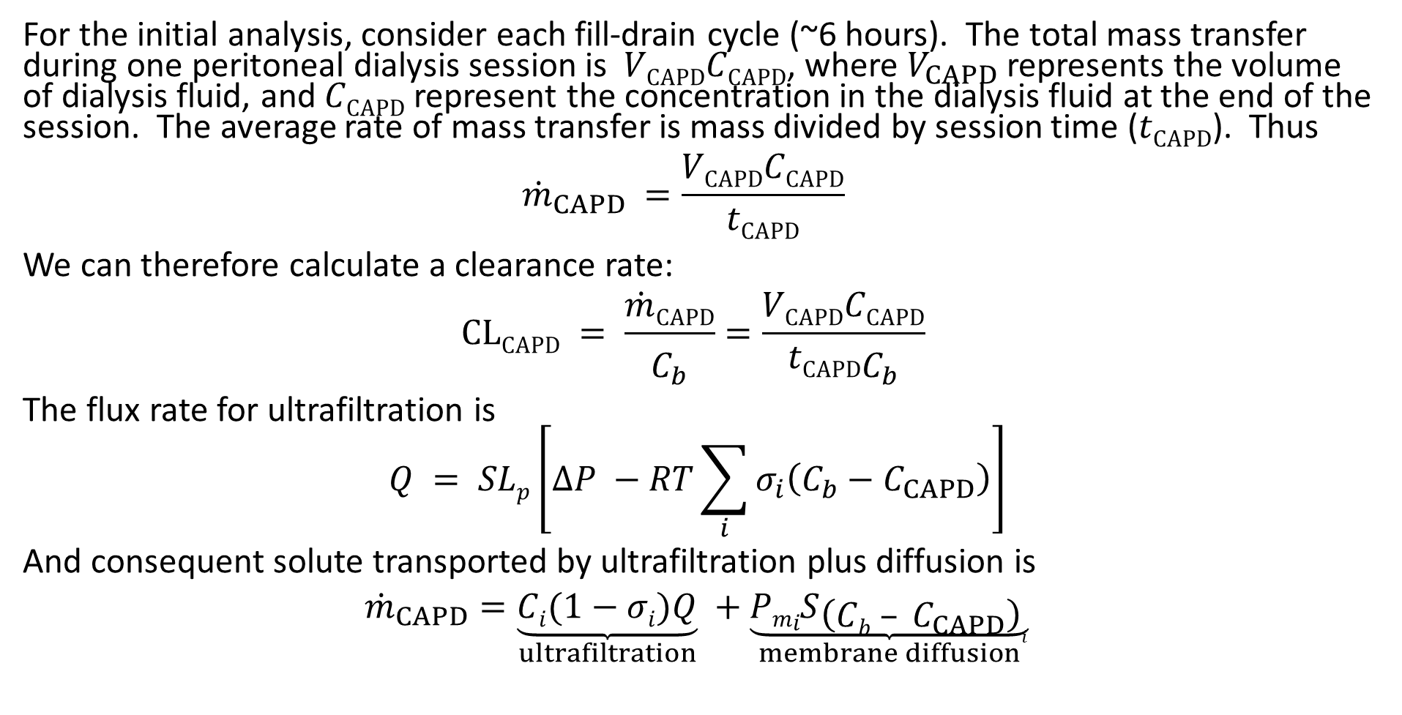
CAPD mass transfer
For the initial analysis, consider each fill-drain cycle (~6 hours). The total mass transfer during one peritoneal dialysis session is $VCAPDCCAPD$, where $V_{CAPD}$ represents the volume of dialysis fluid, and $CCAPD$ represent the concentration in the dialysis fluid at the end of the session. The average rate of mass transfer is mass divided by session time ($tCAPD$). Thus
$${\dot{m}}_{CAPD} =\frac{VCAPDCCAPD}{tCAPD}$$
We can therefore calculate a clearance rate:
$$CLCAPD = \frac{\dot{m}CAPD}{C_{b}}=\frac{VCAPDCCAPD}{tCAPDC_{b}}$$
The flux rate for ultrafiltration is
$$Q = SLp\left[∆P −RT\sum_{i}{σ_{i}\left(C_{b}−C_{CAPD}\right)}\right]$$
And consequent solute transported by ultrafiltration plus diffusion is
$${\dot{m}}_{CAPD}=\underset{ultrafiltration}{\underbrace{Ci(1−σi)Q}} +\underset{membrane diffusion}{\underbrace{PmiS{\left(Cb – C_{CAPD}\right)}_{i}}}$$

Slide 25
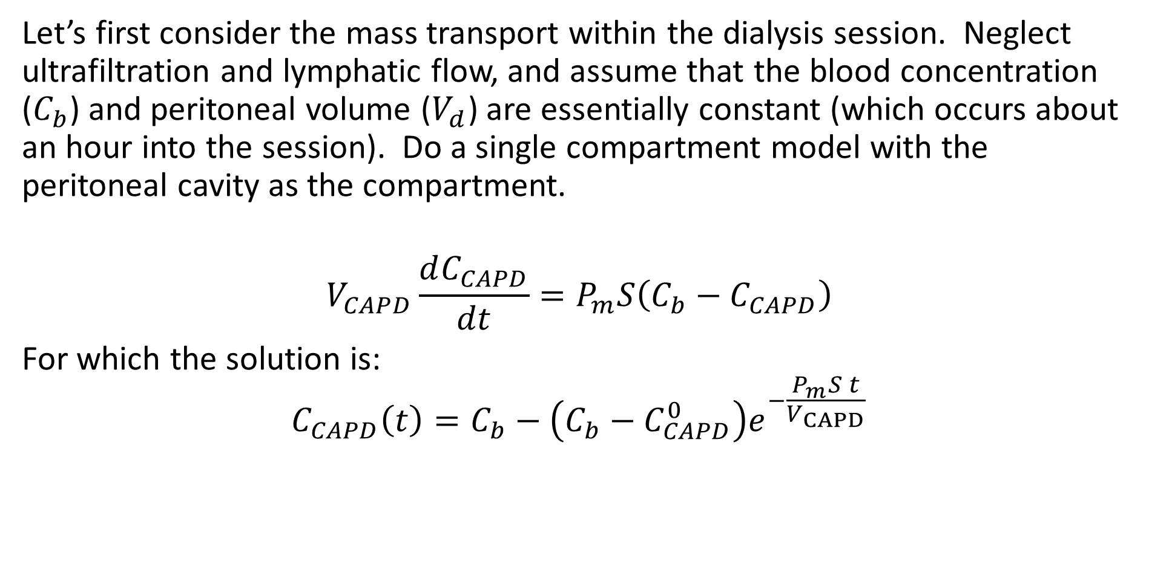
CAPD constant volume model
Let’s first consider the mass transport within the dialysis session. Neglect ultrafiltration and lymphatic flow, and assume that the blood concentration ($C_{b}$) and peritoneal volume ($V_{d}$) are essentially constant (which occurs about an hour into the session). Do a single compartment model with the peritoneal cavity as the compartment.
$$V_{CAPD}\frac{dC_{CAPD}}{dt}=P_{m}S\left(C_{b}−C_{CAPD}\right)$$
For which the solution is:
$$C_{CAPD}\left(t\right)=C_{b}−\left(C_{b}−C_{CAPD}^{0}\right)e^{−\frac{P_{m}S t}{V_{CAPD}}}$$

Slide 26
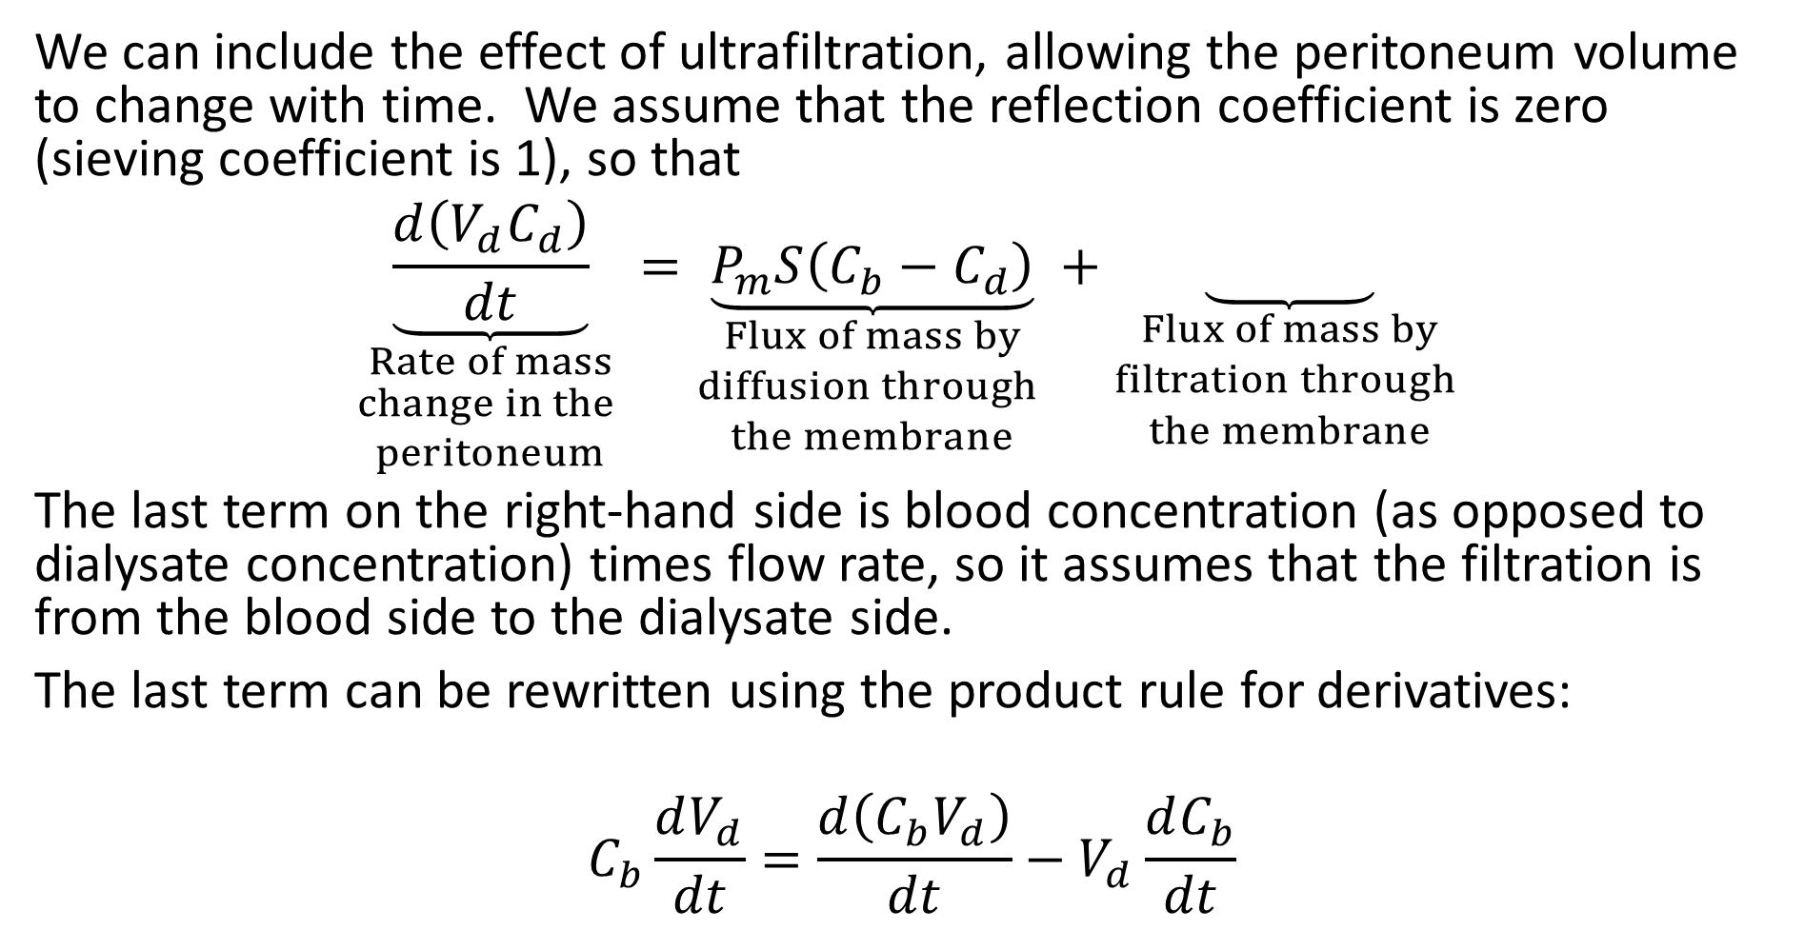
CAPD model with ultrafiltration
We can include the effect of ultrafiltration, allowing the peritoneum volume to change with time. We assume that the reflection coefficient is zero (sieving coefficient is 1), so that
$$\underset{\begin{aligned}Rate of mass \\ change in the \\ peritoneum\end{aligned}}{\underbrace{\frac{d\left(V_{d}C_{d}\right)}{dt}}}=\underset{\begin{aligned}Flux of mass by \\ diffusion through \\ the membrane\end{aligned}}{\underbrace{P_{m}S\left(C_{b}−C_{d}\right)}}+\underset{\begin{aligned}Flux of mass by \\ filtration through \\ the membrane\end{aligned}}{\underbrace{ }}$$
The last term on the right-hand side is blood concentration (as opposed to dialysate concentration) times flow rate, so it assumes that the filtration is from the blood side to the dialysate side.
The last term can be rewritten using the product rule for derivatives:
$$C_{b}\frac{dV_{d}}{dt}=\frac{d\left(C_{b}V_{d}\right)}{dt}−V_{d}\frac{dC_{b}}{dt}$$

Slide 27
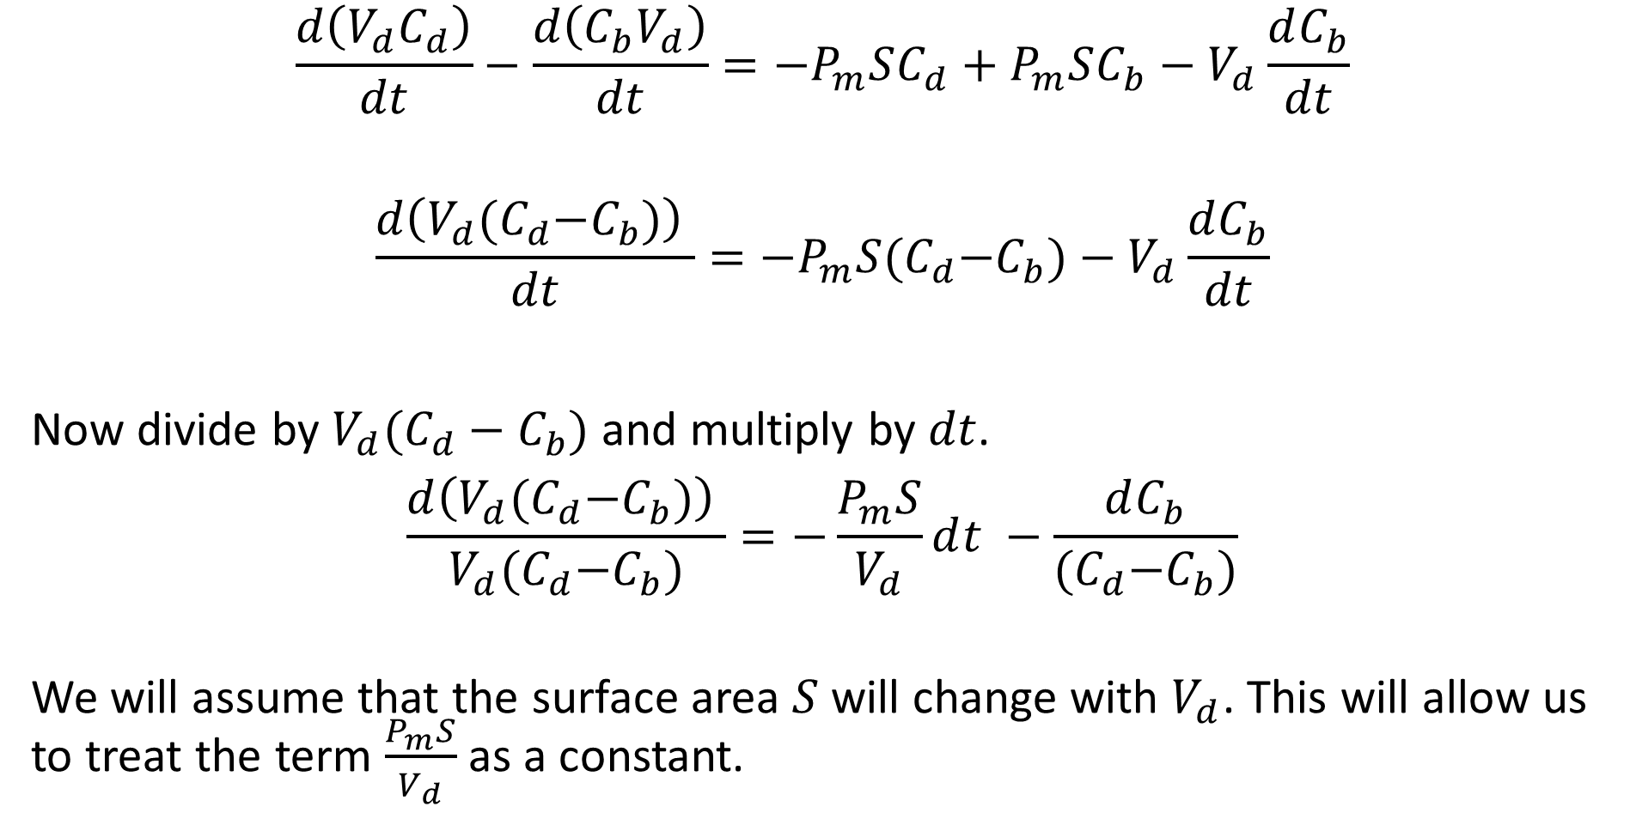
CAPD model with ultrafiltration
$$\frac{d\left(V_{d}C_{d}\right)}{dt}−\frac{d\left(C_{b}V_{d}\right)}{dt}=−P_{m}SC_{d}+P_{m}SC_{b}−V_{d}\frac{dC_{b}}{dt}$$
$$\frac{d\left(V_{d}{(C}_{d}−C_{b})\right) }{dt}=−P_{m}S{(C}_{d}−C_{b})−V_{d}\frac{dC_{b}}{dt}$$
Now divide by $V_{d}(C_{d}−C_{b})$ and multiply by $dt$.
$$\frac{d\left(V_{d}{(C}_{d}−C_{b})\right) }{V_{d}{(C}_{d}−C_{b})}=−\frac{P_{m}S}{V_{d}}ⅆt −\frac{dC_{b}}{{(C}_{d}−C_{b})}$$
We will assume that the surface area $S$ will change with $V_{d}$. This will allow us to treat the term $\frac{P_{m}S}{V_{d}}$ as a constant.

Slide 28
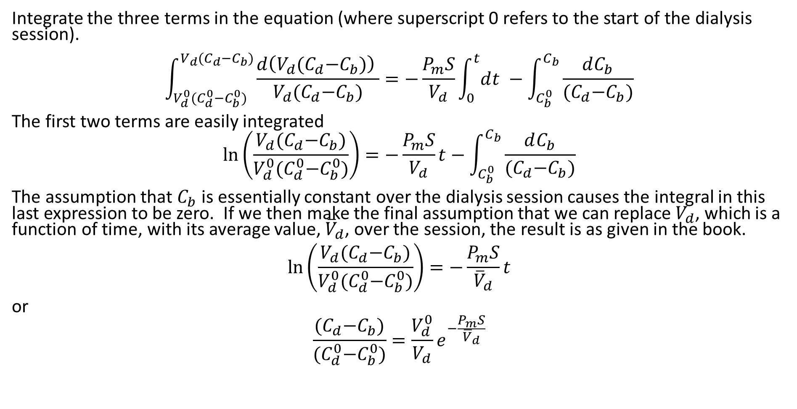
CAPD model with ultrafiltration
Integrate the three terms in the equation (where superscript 0 refers to the start of the dialysis session).
$$\int_{V_{d}^{0}{(C}_{d}^{0}−C_{b}^{0})}^{V_{d}{(C}_{d}−C_{b})}{\frac{d\left(V_{d}{(C}_{d}−C_{b})\right) }{V_{d}{(C}_{d}−C_{b})}}=−\frac{P_{m}S}{V_{d}}\int_{0}^{t}{ⅆt} −\int_{C_{b}^{0}}^{C_{b}}{\frac{dC_{b}}{{(C}_{d}−C_{b})}}$$
The first two terms are easily integrated
$$\ln\left(\frac{V_{d}{(C}_{d}−C_{b})}{V_{d}^{0}{(C}_{d}^{0}−C_{b}^{0})}\right)=−\frac{P_{m}S}{V_{d}}t−\int_{C_{b}^{0}}^{C_{b}}{\frac{dC_{b}}{{(C}_{d}−C_{b})}}$$
The assumption that $C_{b}$ is essentially constant over the dialysis session causes the integral in this last expression to be zero. If we then make the final assumption that we can replace $V_{d}$, which is a function of time, with its average value, ${\overline{V}}_{d}$, over the session, the result is as given in the book.
$$\ln\left(\frac{V_{d}{(C}_{d}−C_{b})}{V_{d}^{0}{(C}_{d}^{0}−C_{b}^{0})}\right)=−\frac{P_{m}S}{{\overline{V}}_{d}}t$$
or
$$\frac{{(C}_{d}−C_{b})}{{(C}_{d}^{0}−C_{b}^{0})}=\frac{V_{d}^{0}}{V_{d}}e^{−\frac{P_{m}S}{{\overline{V}}_{d}}}$$

Slide 29
Aquapheresis
___________ Heart Failure (CHF) is a very complex chronic disease in which the heart loses the ability to effectively pump blood. CHF is usually a result of myocardial infarctions, heart disease (e.g., cardiomyopathy), high blood pressure, and heart valve problems.
Because of the CHF, fluid can accumulate (congestion) in various organs such as the lungs, liver, and kidneys.
_______________ is the treatment to remove the excess fluid and salt using hollow fiber membrane cartridges similar to those in HD.
It is similar to dialysis, except that the goal is removal of fluid only without changing the blood constituents.
Fluid removal is by ___________, rather than diffusion, so the content of the dialysis-side fluid is less important. (Flux is outward, not into the blood).

